Slide 1


Session I
REALSOFT-ME.COM

Slide 2

Web Development Training

Slide 3
Sessions Overview
Session I: HTML
How to structure content in your webpage
Session I: CSS
How to style the content in your webpage
Session II: JS
Interactive content
Add events to your webpage
Session III: NodeJS
How to setup a server
deal with files
Database CRUD operations in Node JS
Session IV: Angular
What is Angular JS

Slide 4
At the end of this session we will be able to:
Construct responsive website layout’s
Develop an understanding of different use cases for CSS positioning and display properties and structure the layout of a web page.
-
-
Develop interactive websites using JavaScript
Use JavaScript to control a webpage and learn what the Document Object Model (DOM) is.
Effectively create the structure of a website using semantic HTML, and style websites with CSS and responsive layouts.
The goal of this training is to equip learners with the unique skills they need to build and develop great websites and applications.

Slide 5
Objectives (Section I: HTML)
Learn the anatomy of HTML syntax to structure your websites.
How to structure text in HTML.
How to structure HTML lists to create unordered and ordered lists.
How to insert images using HTML
How to create hyperlinks using anchor tags.
Understand how to use HTML tables for content.
Understand HTML forms
HTML Divs and how to separate content for CSS styling

Slide 6

RESOURCES
Head First HTML & CSS (Book)
W3schools (Documentation)
https://devdocs.io/
https://developer.mozilla.org/en-US/
Notes:
https://blog.isquaredsoftware.com/presentations/2016-10-revolution-of-web-dev/#/?_k=z5x4yk

Slide 7
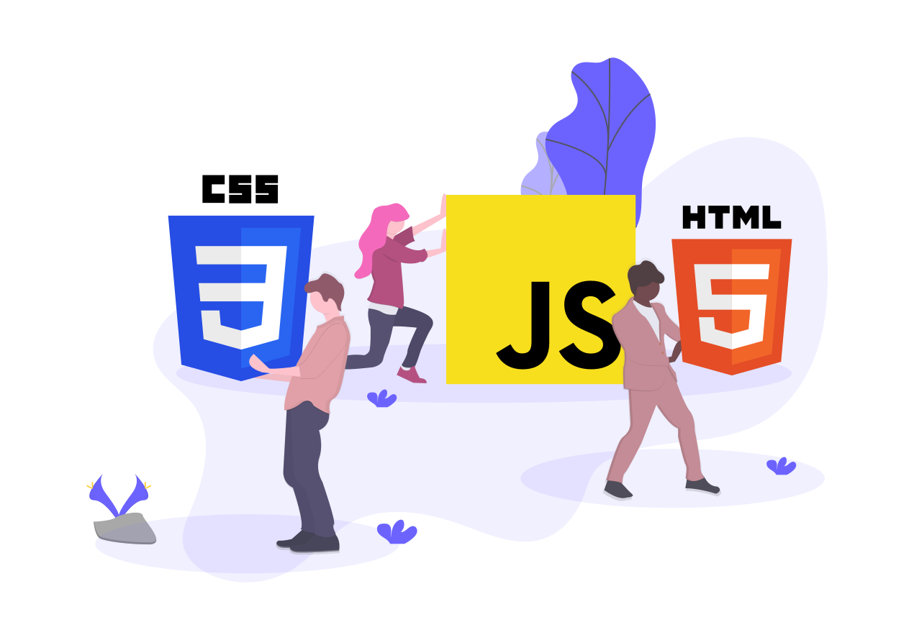
HTML is used to:
Show data to users of your site.
This data can be anything, videos, images, text.
Your browser downloads the data and displays it on the page.
Collect data from your users.
It does this using forms, and inputs that take in things like a username or password, or a comment for a blog post.
Sometimes you want to display this data for other users, sometimes you want to save it for later.
Connect your website to other sites through links (hyperlinks).
Most modern apps are a single page and mimic this behavior.
You can also link to other sites on the web or a specific page on another site.

Slide 8
CSS is the look and feel.
It answers questions like
“What does the cover look like?”
“What color and size is the text?”
“How large are the images?”
CSS has three main components, the style of the page, the layout of the page, and any movement on the page.

Slide 9
HTML -> STRUCTURE
CSS -> STYLE
JS -> Behavior
https://codepen.io/giana/pen/GJMBEv
Notes:
HTML – nouns
CSS - adjectives
JS – verbs
-------------------------
EXAMPLES
“THE RED CAR IS MOVING” RED -> CSS / CAR -> HTML / MOVING -> JS
“THE FLUFFY CAT IS SLEEPING” …
https://codepen.io/giana/pen/GJMBEv
Try to remove the CSS & JS

Slide 10

What is HTML?
HTML stands for Hyper Text Markup Language
HTML is the standard markup language for creating Web pages
HTML describes the structure of a Web page
Notes:
It is a markup language that tells web browsers how to structure the web pages you visit
Each tag describes some kind of content
Markup -> لغة الترميز أو لغة توصيف النص
HTML5 is the latest evolution of the standard that defines HTML. It includes new elements & features for browsers to implement,

Slide 11

What is HTML?
HTML consists of a series of elements
HTML elements tell the browser how to display the content
HTML elements label pieces of content such as
"this is a heading",
"this is a paragraph",
"this is a link"
Notes:
Each tag describes some kind of content

Slide 12
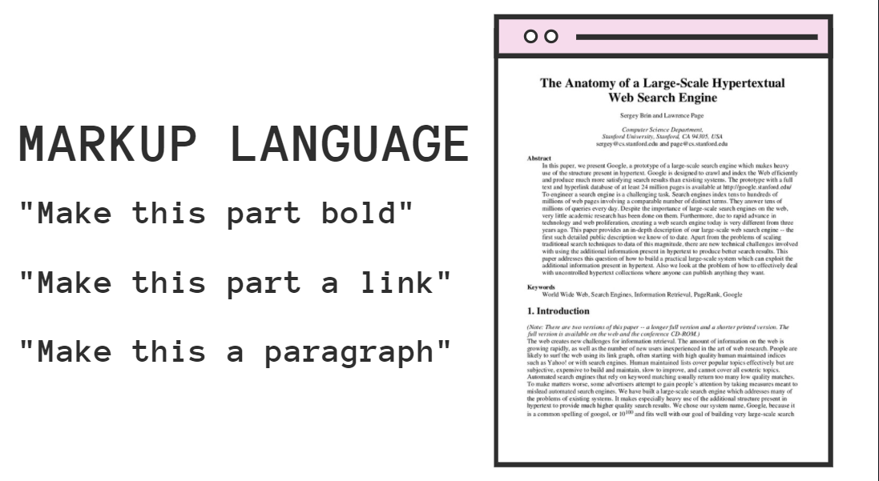

Slide 13
HTML is the markup language that we use to structure and give meaning to our web content, for example defining paragraphs, headings, and data tables, or embedding images and videos
CSS is a language of style rules that we use to apply styling to our HTML content, for example setting background colors and fonts, and laying out our content in multiple columns.
JavaScript is a scripting language that enables you to create dynamically updating content, control multimedia, animate images
Notes:
(HTML for content, css for style, JS for behavoiur)

Slide 14
HTML INSIDE THE BROWSER
The browser reads your HTML, and it interprets all the tags that surround your text.
Tags are words or characters in angle brackets, like <input>, <p>, <h1>
The tags tell the browser about the structure and meaning of your text.
Notes:
POINT 3) So rather than just giving the browser a bunch of text, with HTML you can use tags to tell the browser what text is in a heading, what text is a paragraph, what text needs to be emphasized, or even where images need to be placed
A browser does not display the HTML tags, but uses them to determine how to display the document

Slide 15

FIRST HTML PAGE

Slide 16
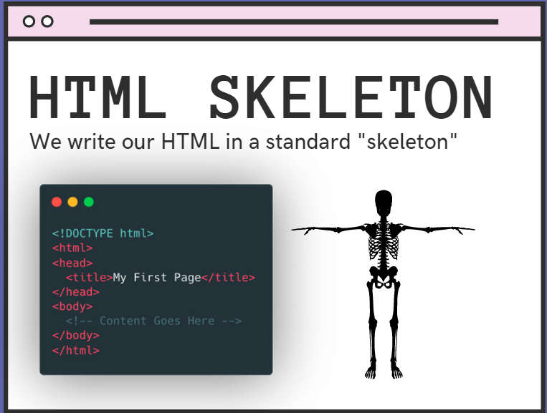

Slide 17
<!DOCTYPE html>
<html
<head> <title>My Title</title> </head>
<body> <h1>First Heading</h1> <p>paragraph.</p> </body>
</html>
First Example
Notes:
Read about each element on MDN
<title> : shown in the browser's title bar or in the page's tab)

Slide 18
First Example
<!DOCTYPE html> defines that this document is HTML5
<html> element is the root element of an HTML page
<head> element contains meta data about the HTML page
<title> element specifies a title for the HTML page
<body> element defines the document's body, and is a container for all the visible contents, such as headings, paragraphs, images, hyperlinks, tables, lists, etc.
<h1> element defines a large heading
<p> element defines a paragraph
Notes:
Read about each element on MDN
<title> : shown in the browser's title bar or in the page's tab)

Slide 19

Setting Up Your Environment
IDE:
VS CODE
OR ANY IDE
VS CODE EXTENSIONS:
HTML CSS Support
CSS Formatter
Material Icon Theme

Slide 20

What is an HTML Element?
An HTML element is defined by a start tag, some content, and an end tag
<tagname> Content </tagname>
The HTML element is everything from the start tag to the end tag

Slide 21

HTML Element Example’s
<h1>My First Heading</h1>
<p>My first paragraph.</p>

Slide 22

HTML ELEMENTS
An HTML element is defined by a start tag, some content, and an end tag.
Tag | Element | Example
Headings | HTML headings are defined with the <h1> to <h6> tags
Paragraphs | <p>This is a paragraph.</p>
Links | <a href="https://www.google.com">This is a link</a>
Images | <img src=“image.jpg" alt=“test image" width="104" height="142">
Lists | <ul><li>Milk</li><li>Cheese<ul><li>Blue cheese</li> <li>Feta</li> </ul> </li></ul>
Notes:
Heading:
<h1> defines the most important heading. <h6> defines the least important heading
LINKS: The link's destination is specified in the href attribute.
1. Absolute URL - Links to an external image that is hosted on another website. Example: src="https://www.test.com/images/img.jpg".
2. Relative URL - Links to an image that is hosted within the website. Here, the URL does not include the domain name.
If the URL begins without a slash, it will be relative to the current page. Example: src="img.jpg".
If the URL begins with a slash, it will be relative to the domain. Example: src="/images/img.jpg".
Tip: It is almost always best to use relative URLs. They will not break if you change domain.
IMAGES:
The alt attribute provides alternative information for an image if a user for some reason cannot view it (because of slow connection, an error in the src attribute, or if the user uses a screen reader). //Good for search engines (so they can know whats the content about)
https://developer.mozilla.org/en-US/docs/Web/Guide/HTML/Content_categories

Slide 23

Understanding attributes
All HTML elements can have attributes
Attributes provide additional information about elements
Attributes are always specified in the start tag
Notes:
What if <car> was an element? then you’d naturally want to write some markup like this:
<car>My Red Mini</car>
But this <car> element only gives a descriptive name for your car—it doesn’t tell us the make, model, whether it is a convertible, and other details.
So, if <car> were really an element, we might use attributes like this:
<car make=“BMW" model="Cooper" convertible=“false">My Red Mini</car>

Slide 24
Understanding attributes
The <a> tag defines a hyperlink.
The href attribute specifies the URL of the page the link goes to

Slide 25
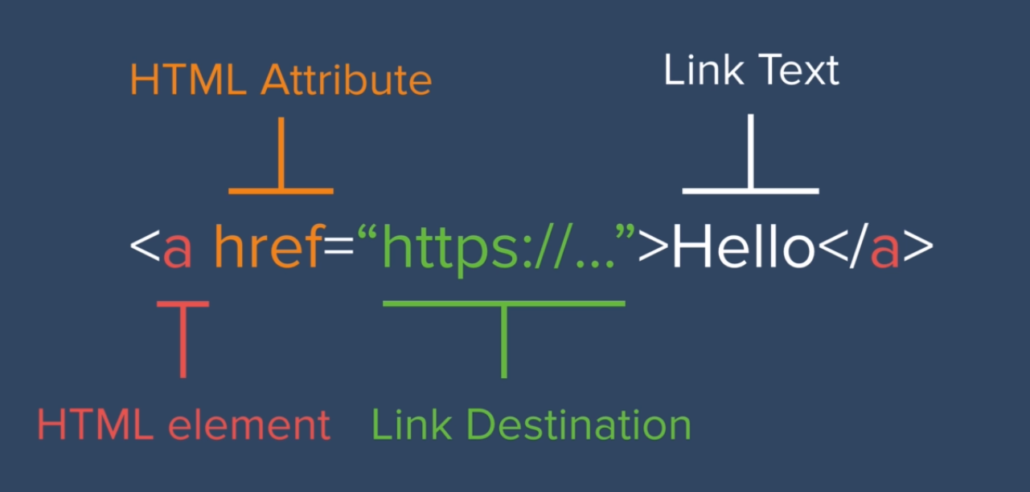
Notes:
you put an <img> element between the <a> tags, then
your image will be clickable just like text.
Use “..” to link to a file that’s one folder above the file you’re linking from.
“..” means “parent folder.”

Slide 26
Tables
HTML tables allow us to arrange data into rows and columns.
The <table> tag defines an HTML table.
Each table row is defined with a <tr> tag.
Each table header is defined with a <th> tag.
Each table data/cell is defined with a <td> tag.
Notes:
By default, the text in <th> elements are bold and centered.
By default, the text in <td> elements are regular and left-aligned
=========================================
<table border="">
<tr>
<th>Company</th>
<th>Country</th>
</tr>
<tr>
<td>Alfreds</td>
<td>Germany</td>
</tr>
<tr>
<td>Centro</td>
<td>Mexico</td>
</tr>
</table>

Slide 27
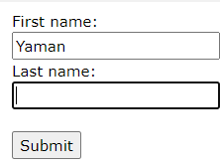
Forms
Forms allow users to enter data (collect user input), which is generally sent to a web server for processing and storage
The <form> element is a container for different types of input elements, such as: text fields, checkboxes, radio buttons, submit buttons, etc.
https://developer.mozilla.org/en-US/docs/Learn/Forms
Notes:
The <form> represents a document section that contains interactive controls for submitting information to a web server.

Slide 28
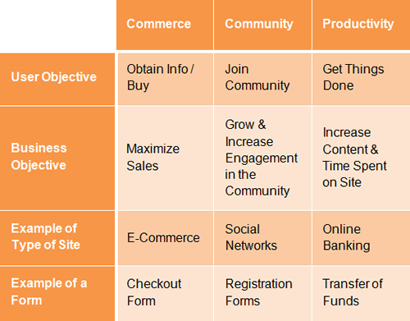
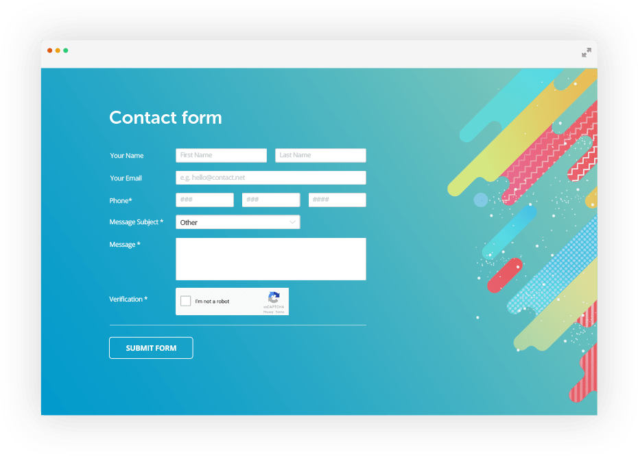


Slide 29


Designing your form
Before starting to code, it's always better to step back and take the time to think about your form.
Designing a quick mockup will help you to define the right set of data you want to ask your user to enter.
From a user experience (UX) point of view, it's important to remember that the bigger your form, the more you risk frustrating people and losing users.
Keep it simple and stay focused: ask only for the data you absolutely need.
An Extensive Guide To Web Form Usability

Slide 30
Components Of Web Forms
Labels
Input Fields
Actions
Help
Messages
Validation
Notes:
Labels These tell users what the corresponding input fields mean.
Input Fields Input fields enable users to provide feedback. They include text fields, password fields, check boxes, radio buttons, sliders and more.
Actions These are links or buttons that, when pressed by the user, perform an action, such as submitting the form.
Help This provides assistance on how to fill out the form.
Messages Messages give feedback to the user based on their input. They can be positive (such as indicating that the form was submitted successfully) or negative (“The user name you have selected is already taken”).
Validation These measures ensure that the data submitted by the user conforms to acceptable parameters.

Slide 31
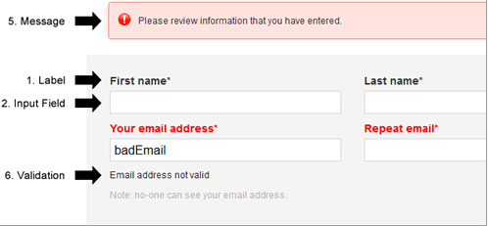
Notes:
Labels These tell users what the corresponding input fields mean.
Input Fields Input fields enable users to provide feedback. They include text fields, password fields, check boxes, radio buttons, sliders and more.
Actions These are links or buttons that, when pressed by the user, perform an action, such as submitting the form.
Help This provides assistance on how to fill out the form.
Messages Messages give feedback to the user based on their input. They can be positive (such as indicating that the form was submitted successfully) or negative (“The user name you have selected is already taken”).
Validation These measures ensure that the data submitted by the user conforms to acceptable parameters.

Slide 32
Form Example
<form action="/my-handling-form-page" method="post"> </form>
<form> contains specific attributes to configure the way the form behaves
The action attribute defines the location (URL) where the form's collected data should be sent when it is submitted.
The method attribute defines which HTTP method to send the data with (usually get or post).
https://www.w3schools.com/code/tryit.asp?filename=GJ67JFA5YG98
Notes:
We will discuss these details in the NodeJS section

Slide 33
The HTML <form> Elements
<form> element can contain one or more of the following elements:
<input>
<label>
<select>
<textarea>
<button>
<fieldset>
<option>
Notes:
Fieldset & legend:
<form action="/">
<fieldset>
<legend>Personalia:</legend>
<label for="fname">First name:</label>
<input type="text" id="fname" name="fname"><br><br>
<label for="lname">Last name:</label>
<input type="text" id="lname" name="lname"><br><br>
<label for="birthday">Birthday:</label>
<input type="date" id="birthday" name="birthday"><br><br>
<input type="submit" value="Submit">
</fieldset>
</form>

Slide 34
The <input> Element
The <input> element can be displayed in several ways, depending on the type attribute.
The <input> tag is an empty element, meaning that it doesn't need a closing tag

Slide 35
HTML Input Types
<input type="button">
<input type="checkbox">
<input type="color">
<input type="date">
<input type="email">
<input type="file">
<input type="number">
<input type="password">
<input type="radio">
<input type="range">
<input type="search">
<input type="submit">
<input type="tel">
<input type="text">
<input type="url">
https://www.w3schools.com/code/tryit.asp?filename=GJ6A1GMGMZTN
Notes:
<!DOCTYPE html>
<html>
<body>
<h2>Input Tag</h2>
<form action="/action_page.php">
<label for="username">Username:</label><br>
<input type="text" id="username" name="username"><br>
<label for="email">Enter your email:</label> <br>
<input type="email" id="email" name="email"> <br>
<label for="pwd">Password:</label><br>
<input type="password" id="pwd" name="pwd"><br><br>
<input type="radio" id="male" name="gender" value="male">
<label for="male">Male</label><br>
<input type="radio" id="female" name="gender" value="female">
<label for="female">Female</label><br>
<br>
<input type="checkbox" id="vehicle1" name="vehicle1" value="Bike">
<label for="vehicle1"> I have a bike</label><br>
<input type="checkbox" id="vehicle2" name="vehicle2" value="Car">
<label for="vehicle2"> I have a car</label><br>
<input type="checkbox" id="vehicle3" name="vehicle3" value="Boat">
<label for="vehicle3"> I have a boat</label>
<br> <br>
<label for="birthday">Birthday:</label>
<input type="date" id="birthday" name="birthday">
<br> <br>
<label for 'favcolor'> Color </label>
<input type="color" id="favcolor" name="favcolor" value="#ff0000">
<br> <br>
<label for="quantity">Quantity (between 1 and 5):</label>
<input type="number" id="quantity" name="quantity" min="1" max="5">
<br><br>
<label for="myfile">Select a file:</label>
<input type="file" id="myfile" name="myfile"><br><br>
<label for="vol">Volume (between 0 and 50):</label>
<input type="range" id="vol" name="vol" min="0" max="50">
<br> <br>
<input type="button" onclick="alert('Hello World!')" value="Click Me!">
<input type="submit" value="Submit">
</form>
</body>
</html>

Slide 36
Form validation
Browsers provide client-side validation functionality to forms.
You can set fields as required, ensuring they are filled, and enforce a specific format for the input of each field.
Examples:
Set fields as required
Enforce a specific format
Notes:
https://flaviocopes.com/javascript-regular-expressions/

Slide 37
Form validation
Set fields as required
The required attribute helps you with validation.
If the field is not set, client-side validation fails, and the browser does not submit the form
<input type="text" name="username" required />

Slide 38
Form validation
Enforce a specific format
I described the type="email" field above. It automatically validates the email address according to a format set in the specification.
In the type="number" field, I mentioned the min and max attribute to limit values entered to an interval.
The pattern attribute gives you the ability to set a regular expression to validate the value against.
<input type="text" name="username" pattern="[a-zA-Z]{8}" />
Notes:
https://flaviocopes.com/javascript-regular-expressions/

Slide 39
Form validation
Enforce a specific format
I described the type="email" field above. It automatically validates the email address according to a format set in the specification.
In the type="number" field, I mentioned the min and max attribute to limit values entered to an interval.
The pattern attribute gives you the ability to set a regular expression to validate the value against.
<input type="file" name="documents" accept=".jpg, .jpeg, .png">

Slide 40
The <label> Element
For usability and accessibility, we include an explicit label for each form control.
<label for="userName">UserName</label>
Note the use of the for attribute on all <label> elements, which takes as its value the id of the form control with which it is associated — this is how you associate a form control with its label.
There is great benefit to doing this — it associates the label with the form control, enabling mouse, trackpad, and touch device users to click on the label to activate the corresponding control, and it also provides an accessible name for screen readers to read out to their users.

Slide 41
ID VS NAME
ID is used to identify HTML element through the Document Object Model (via JavaScript or styled with CSS).
ID is expected to be unique within the page.
Name corresponds to the form element and identifies what is posted back to the server.
Several radio buttons will have the same name. When submitted, there is just the one value in the response
Notes:
When a web page is loaded, the browser creates a Document Object Model of the page.
The HTML DOM model is constructed as a tree of Objects
It defines:
The HTML elements as objects
The properties of all HTML elements
The methods to access all HTML elements
The events for all HTML elements
In other words: The HTML DOM is a standard for how to get, change, add, or delete HTML elements.
---------------------------------------------
Several radio buttons will have the same name. When submitted, there is just the one value in the response - the radio button you selected.

Slide 42
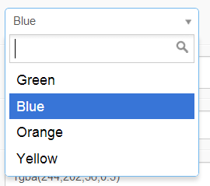
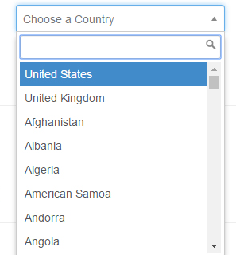
The <select> Element
The <select> element defines a drop-down list.
The <option> elements defines an option that can be selected.
https://www.w3schools.com/code/tryit.asp?filename=GJ6A9064TOET

Slide 43
The <select> Element
By default, the first item in the drop-down list is selected.
To define a pre-selected option, add the selected attribute to the option
Use the size attribute to specify the number of visible values
https://www.w3schools.com/code/tryit.asp?filename=GJ6A9064TOET
Notes:
<select id="cars" name="cars" size="3">
<option value="volvo">Volvo</option>
<option value="saab">Saab</option>
<option value="fiat">Fiat</option>
<option value="audi">Audi</option>
</select>
<br><br>
<select id="cars" name="cars">
<option value="volvo">Volvo</option>
<option value="saab">Saab</option>
<option value="fiat" selected>Fiat</option>
<option value="audi">Audi</option>
</select>

Slide 44
The <button> Element
The <button> element also accepts a type attribute — this accepts one of three values: submit, reset, or button.
The main advantage of the <button> element is that the <input> element only allows plain text in its label whereas the <button> element allows full HTML content, allowing more complex, creative button content.
Notes:
A click on a submit button sends the form's data to the web page defined by the action attribute of the <form> element.
A click on a reset button resets all the form widgets to their default value immediately. From a UX point of view, this is considered bad practice, so you should avoid using this type of button unless you really have a good reason to include one.
A click on a button button does... nothing! That sounds silly, but it's amazingly useful for building custom buttons — you can define their chosen functionality with JavaScript.

Slide 45
Grouping Widgets
The <fieldset> element is a convenient way to create groups of widgets that share the same purpose, for styling and semantic purposes.
You can label a <fieldset> by including a <legend> element just below the opening <fieldset> tag.
The text content of the <legend> formally describes the purpose of the <fieldset> it is included inside.
https://www.w3schools.com/code/tryit.asp?filename=GJ69ZB2IYUHX
Notes:
The <fieldset> element is used to group related data in a form.
The <legend> element defines a caption for the <fieldset> element.

Slide 46
Handle Form Data (on the server side)
The <form> element defines where and how to send the data thanks to the action and method attributes.
The names are important on both the client- and server-side; they tell the browser which name to give each piece of data and, on the server side, they let the server handle each piece of data by name.
The form data is sent to the server as name/value pairs.

Slide 47
Tips
Emmet Shortcuts
https://docs.emmet.io/cheat-sheet/
IDE Shortcuts:
Show Suggestions: ctrl + Space
Multiple selections: hold alt and click
Toggle SideBar: ctrl+B
Duplicate UP: alt+shoft+up arrow
Duplicate Down: alt+shift+down arrow
Comment Selection: ctrl + /
Format document: alt + shift + f
Notes:
div>ul>li>h2 (CHILD NESTING)
ul>li*3 (MULTIPLE ELEMENTS)
ul+div+a (ADJACENT ELEMENTS)

Slide 48

Styling your website using CSS

Slide 49
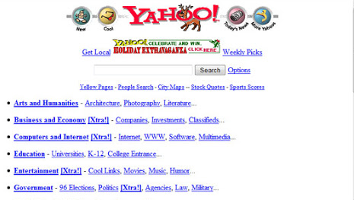
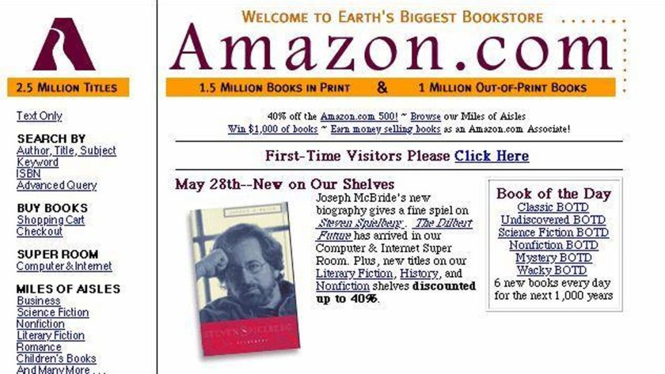
Looking Bad? Look at some popular website back then … without CSS
https://archive.org/web/
Notes:
Prof Thomas Website:
https://www.cs.dartmouth.edu/~thc/
https://www-cs-faculty.stanford.edu/~knuth/

Slide 50

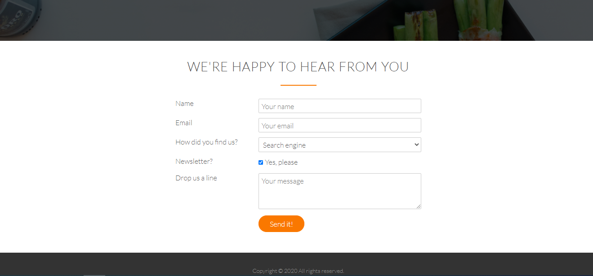
Session II
HTML
Headers
Hyperlinks
Images
Div
Span
Forms
CSS
Fonts
Colors
Backgrounds
Positioning

Slide 51
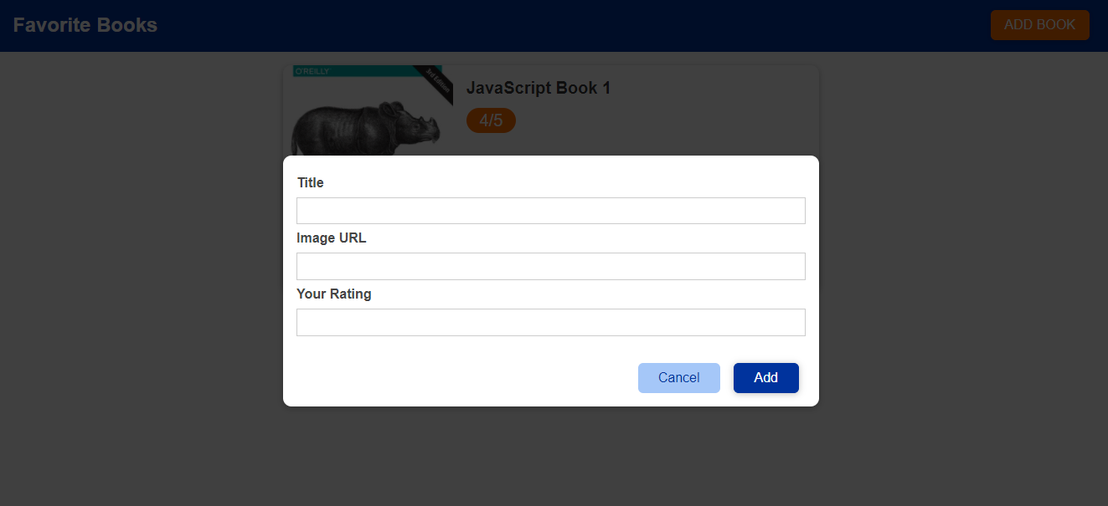
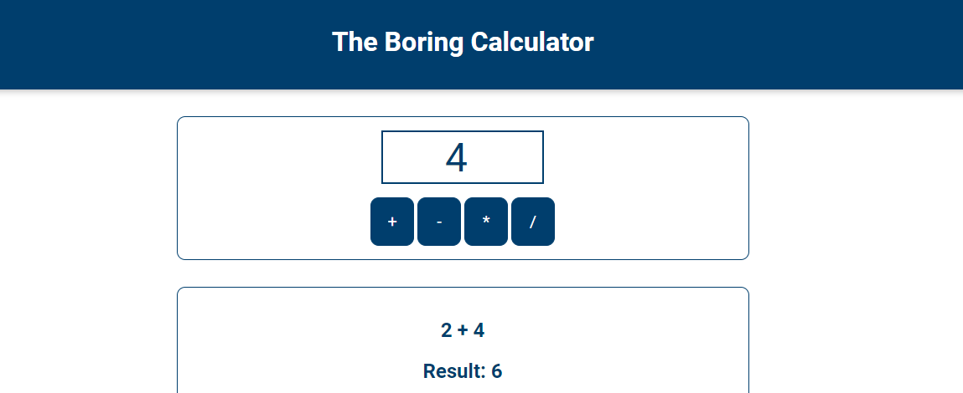
Session III
CSS
Colors
Positioning
JS
Events
Query Selectors

Slide 52
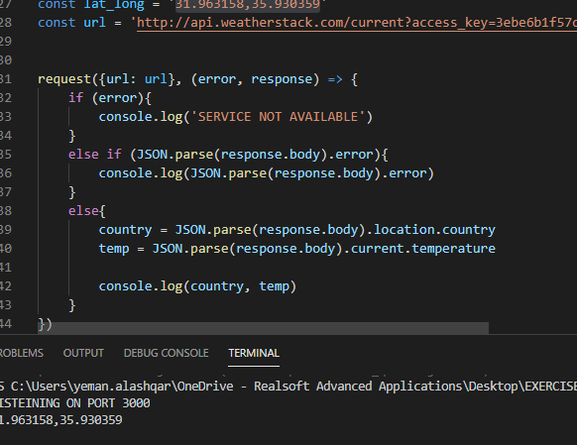
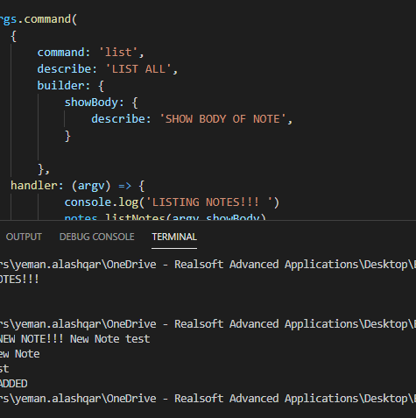
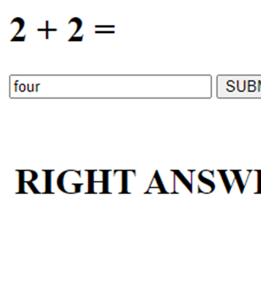
Session IV
NODE JS
File System
Command Line
Arrays
JSON
Express JS

Slide 53
End Of
Session I
REALSOFT-ME.COM

